Slide 1
Develop an Online Registration form for a Training Institution.
Module Project
Module: Programming Foundations
Course: ITSF - Programming Foundations
Start Date : 13/12/2021
End Date : 17/01/2022
Submission Date : 17/01/2022
Learner Name : Joshua Ho Gwok Hin
Enrollment ID : hgh.Joshua@gmail.co
Presentation Date : 17/01/2022

Slide 2
Contents
Table of Contents
Project Definition
Project Deliverables
Project Environment
Project Milestones & Tasks
Create a Form UI Design (1)
System Block Diagram and Tools (2)
Type of Control for Each Field (3)
Screen capture of the Form (4)
UAT Test Cases (5)
Milestone Feedback & Action Taken
Project Results
Proposed Improvements
Notes:
2

Slide 3
1. Project Definition
Project Objective
ABC Learning Center intends to capture student details at the time of enrolment in an online application developed in JSP and MySQL.
To achieve the expectations of the training institute’s request, we will be doing the following:
To design a registration form so that student details can be captured.
The information entered will be first validated before posting to the server
The posted data will be saved to MySQL RDBMS
Prepare Test Planning and Execution Script for UAT
Technical document and user manual
Target project result:
With implementation of an Online Student Registration Form developed in JSP and MySQL, the company can now allow users to register for courses made available by admin. This enabled the training institution to capture student details, and also enhancing productivity by reducing possible confusion over outdated offers.
Notes:
3

Slide 4
2. Project Deliverables
Project Deliverables
Content to be submitted
Includes the following from previous assignment(s)
JSP
course_action.jsp
course_list.jsp
delete.jsp
edit_course.jsp
header.jsp
home.jsp
update_action.jsp
HTML
course.html
JSP
register.jsp – Registration Form
student_action.jsp – Form Action
HTML
thankyou.html
Included in student_action.jsp
<%@ include file=“thankyou.html” %>
Project Report
PFS_1121A_Report_Joshua.docx
PFS_1121A_Presentation_Joshua.pptx
Source Code
jdbc.zip
pfs_1121a_coursemaster.sql
pfs_1121a_studentregister.sql
Notes:
4

Slide 5
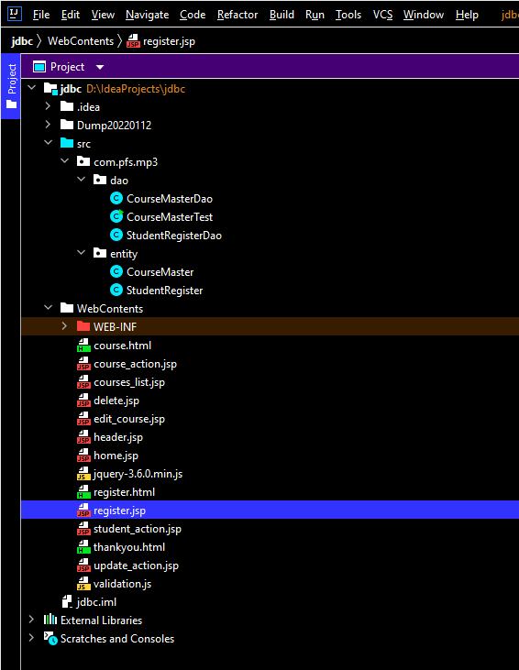
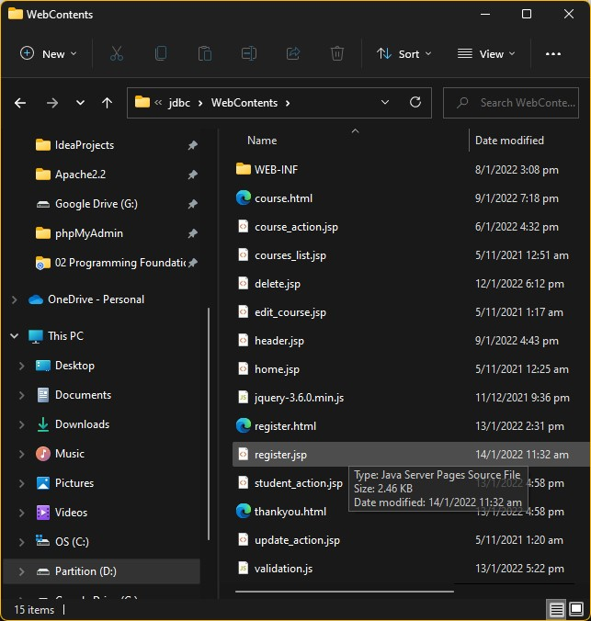
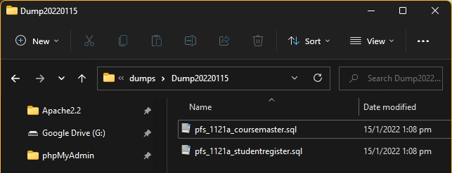
2. Project Deliverables
List of Evidences

Slide 6
3. Project Environment
Technical Environment and Tools Used
Type | Tool
Operating System (OS) | Windows 11
Integrated Development Environment (IDE)/Editor | Intellj IDEA Community Edition 2021.3
Server to run JSP files on webpages | Apache Tomcat 9
Java Runtime Environment | JDK 1.8.0
Web Browser | Edge, Chrome & Firefox
Relational Database Management System | MySQL Workbench 8.0
For screenshot of tools used, kindly refer to slide no.10 in System Block Diagram and Tools (2)

Slide 7
4. Project Milestones & Tasks
Project Task Description
Project Task ID | Project Task Description | Project Milestone ID
1 | Create a Form UI Design (A1) | 2
2 | System Block Diagram & Tools (K2, A2) | 3
3 | Type of Control for Each field (K3, A3) | 4
4 | Include HTML Form portion (K3, A3) | 6
5 | Develop 5 UAT Test Cases for Validation (K4, A4) | 8
Notes:
7

Slide 8
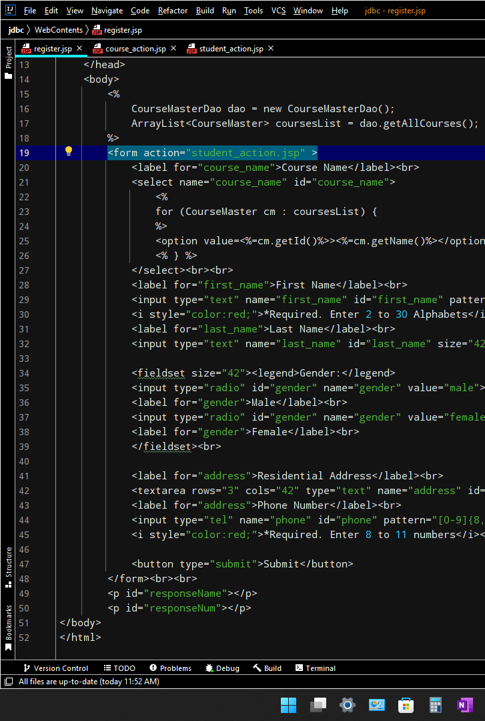
5. Create a Form UI Design (1)
Form UI Design
Course Name
HTML Fundamentals ▽
First name
2 to 30 Alphabets
*Required. Enter 2 to 30 Alphabets
Last Name
Gender
🔘 Male
🔘 Female
Residential Address
Phone Number
Enter 8 to 11 Numbers
*Required. Enter 8 to 11 numbers
Submit

Slide 9
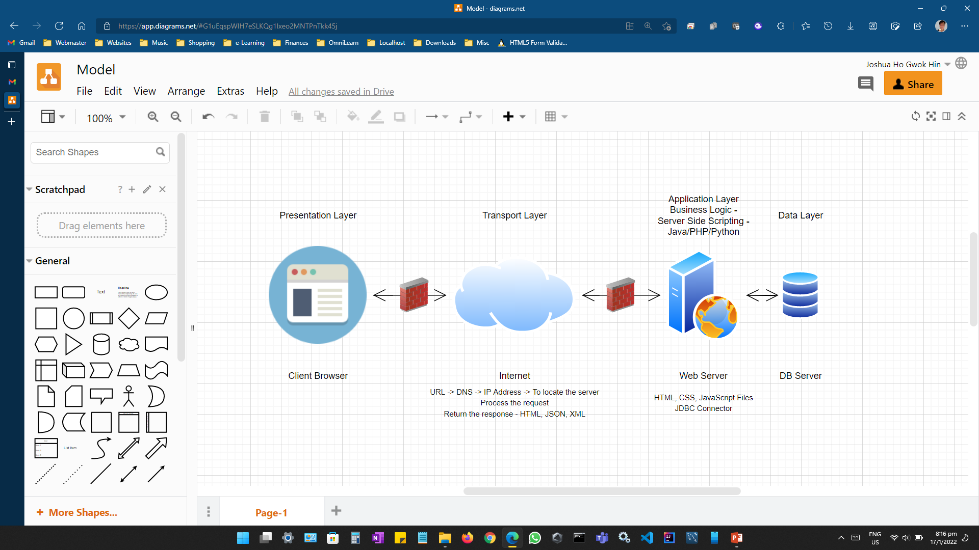
6. System Block Diagram and Tools (2)
System Design
Notes:
9

Slide 10
6. System Block Diagram and Tools (2)
Tools
https://app.diagrams.net/

Slide 11
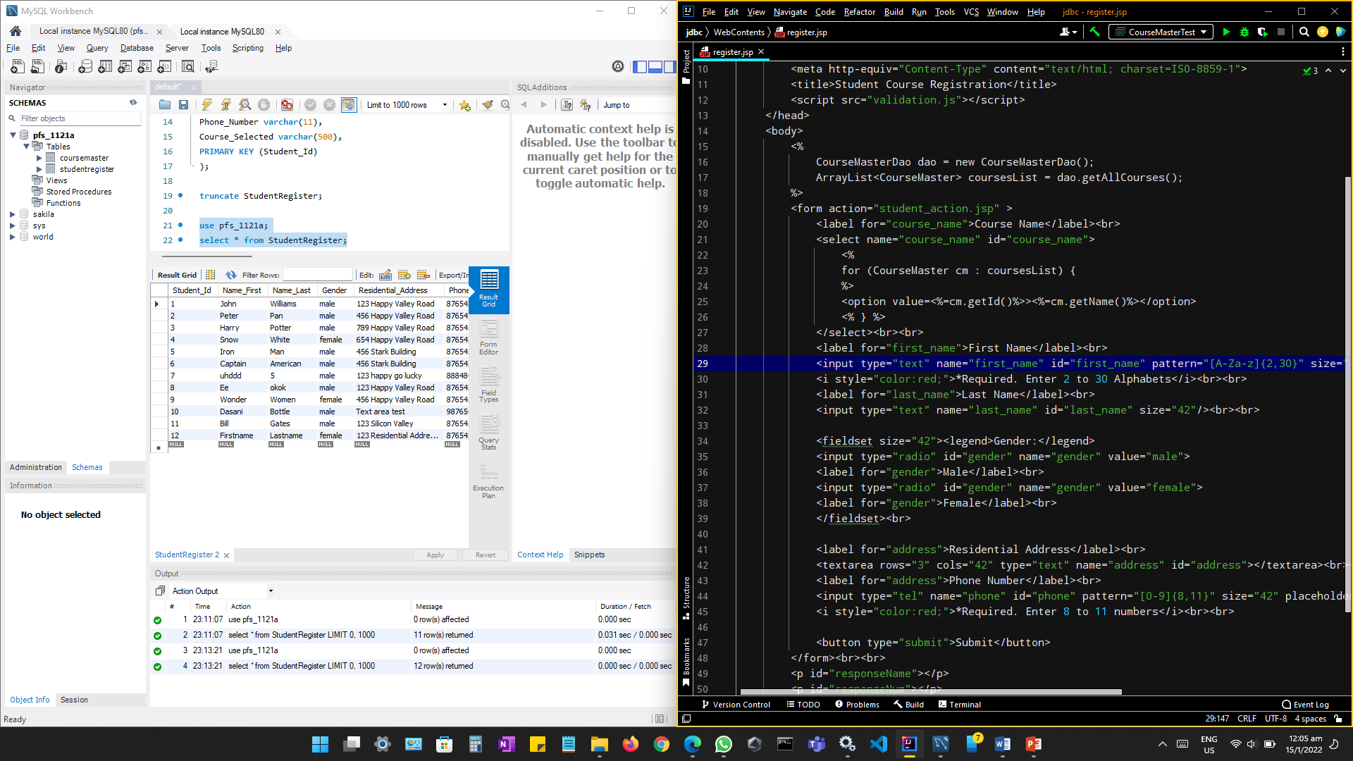
6. System Block Diagram and Tools (2)
Tools
MySQL Workbench
Intellj IDEA Community Edition 2021.3
Notes:
11

Slide 12
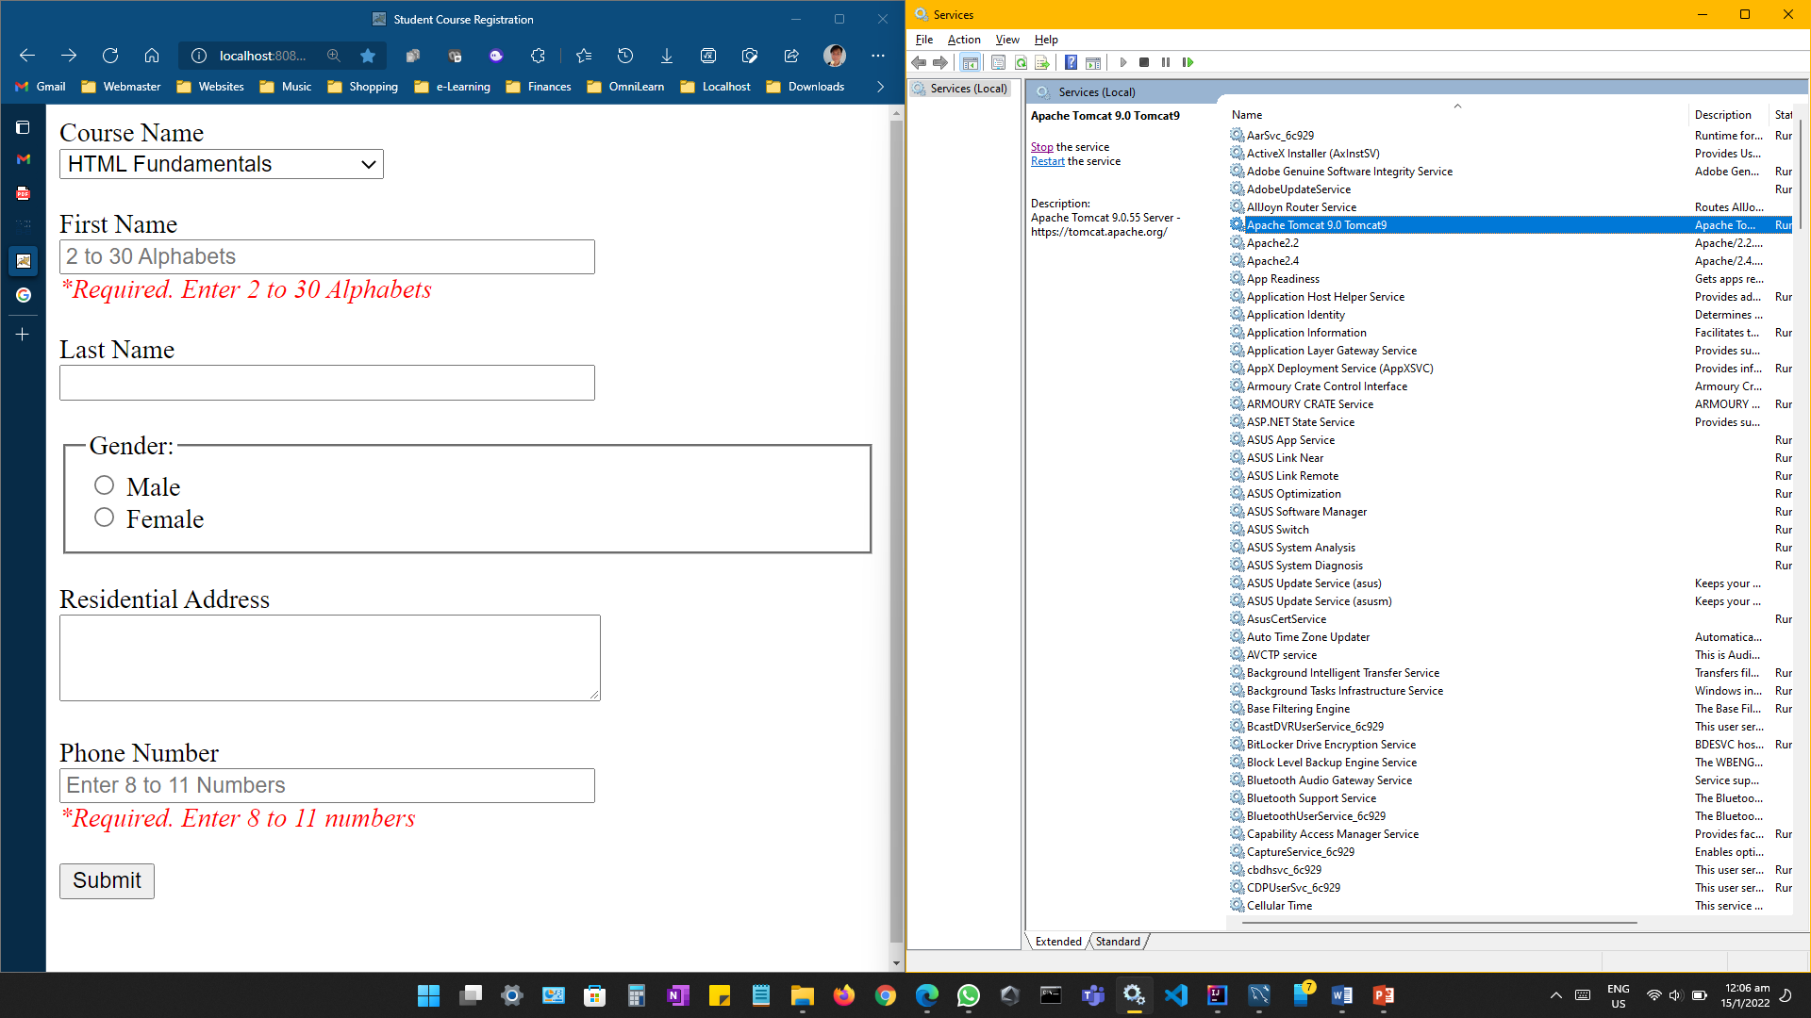
6. System Block Diagram and Tools (2)
Tools
Edge Browser
Apache Tomcat 9.0 Tomcat9

Slide 13
7. Type of Control for Each Field (3)
MySQL Data Dictionary
Table: STUDENTREGISTER
Field Name | Field Type | Field Width | Mandatory | Reference | Default Value | Comments | Sample Value
Student_Id | INT |  | Yes | Primary Key |  | Auto Increment | 1
Name_First | VARCHAR | 30 | Yes |  |  |  | John
Name_Last | VARCHAR | 30 | No |  |  |  | Williams
Gender | VARCHAR | 6 | No |  |  |  | Male
Residential Address | VARCHAR | 500 | No |  |  |  | 123 Happy Road
Phone_Number | VARCHAR | 11 | No |  |  |  | 87654321
Course_Selected | INT |  | No | Coursemaster: Course_Id |  |  | 1
Table: COURSEMASTER
Field Name | Field Type | Field Width | Mandatory | Reference | Default Value | Comments | Sample Value
Course_Id | INT | Field Width | Yes | Primary Key |  | Auto Increment | 1
Course_Name | VARCHAR | 255 | Yes |  |  |  | MySQL
Course_Text | VARCHAR | 255 | Yes |  |  |  | SQL Syntax and MySQL RDBMS

Slide 14
7. Type of Control for Each Field (3)
HTML Form Element Control
HTML Form Elements id | TYPE
course_name | <select><option></option></select>
first_name | “text” pattern="[A-Za-z]{2,30}“ required
last_name | “text”
gender | “radio” value=“Male”, “radio” value=“Female”
address | “text”
phone | “tel” pattern=“[0-9]{8,11}” required

Slide 15
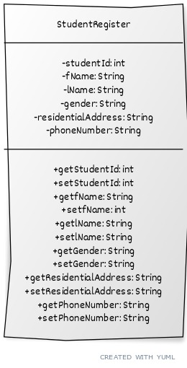
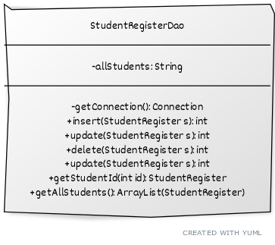
7. Type of Control for Each Field (3)
Classes & Methods used
Domain Class: StudentRegister (POJO)
CRUD Operations: StudentRegisterDao

Slide 16
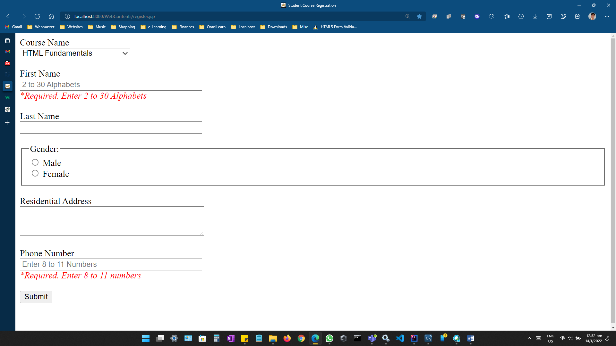
8. Screen capture of the Form (4)
Screen capture of the form
http://localhost:8080/WebContents/register.jsp

Slide 17
9. UAT Test Cases (5)
Test Planning/ Test Script
Step ID. | Test Scenario | Test Case | Test Description | Test Data | Expected Output
1 | Validation for “first_name”. | No Value | Should NOT be able to proceed to post the data | Nothing | Show Error Message: “Please fill out this field.”
2 | Validation for “first_name”. | Numeric Values | Should NOT be able to proceed to post the data | 87654321 | Show Error Message: “Please match the required format.”
3 | Validation for “first_name”. | Alphanumeric Values | Should NOT be able to proceed to post the data | James 007 | Show Error Message: “Please match the required format.”
4 | Validation for “first_name”. | Alphabets only. | Should proceed to next field for further validation. | James | No error for field id “first_name”
5 | Validation for “phone”. | No Value | Should NOT be able to proceed to post the data | Nothing | Show Error Message: “Please fill out this field.”
6 | Validation for “phone”. | Alphabets | Should NOT be able to proceed to post the data | My Number | Show Error Message: “Please match the required format.”
7 | Validation for “phone”. | Alphanumeric Values | Should NOT be able to proceed to post the data | SG87654321 | Show Error Message: “Please match the required format.”
8 | Validation for “phone”. | Numeric Values of 12 char | Should NOT be able to proceed to post the data | 987654321012 | Show Error Message: “Please match the required format.”
9 | Validation for “phone”. | Numeric Values of 11 char | Should proceed to post the data | 98765432101 | Thank you! James you have successfully registered for 1 course.

Slide 18
9. UAT Test Cases (5)
Test Case Execution
Step ID. | Test Scenario | Test Case | Test Description | Test Data | Expected Output | Actual Output | Result | Additional Note
1 | Validation for “first_name”. | No Value | Should NOT be able to proceed to post the data | Nothing | Show Error Message: “Please fill out this field.” | Please fill out this field. | Pass
2 | Validation for “first_name”. | Numeric Values | Should NOT be able to proceed to post the data | 87654321 | Show Error Message: “Please match the required format.” | Please match the required format. | Pass
3 | Validation for “first_name”. | Alphanumeric Values | Should NOT be able to proceed to post the data | James 007 | Show Error Message: “Please match the required format.” | Please match the required format. | Pass
4 | Validation for “first_name”. | Alphabets only. | Should proceed to next field for further validation. | James | No error for field id “first_name” | No error. | Pass | Proceed to next Step ID without removing field.
5 | Validation for “phone”. | No Value | Should NOT be able to proceed to post the data | Nothing | Show Error Message: “Please fill out this field.” | Please fill out this field. | Pass
6 | Validation for “phone”. | Alphabets | Should NOT be able to proceed to post the data | My Number | Show Error Message: “Please match the required format.” | Please match the required format. | Pass
7 | Validation for “phone”. | Alphanumeric Values | Should NOT be able to proceed to post the data | SG87654321 | Show Error Message: “Please match the required format.” | Please match the required format. | Pass
8 | Validation for “phone”. | Numeric Values of 12 char | Should NOT be able to proceed to post the data | 987654321012 | Show Error Message: “Please match the required format.” | Please match the required format. | Pass
9 | Validation for “phone”. | Numeric Values of 11 char | Should proceed to post the data | 98765432101 | Thank you! James you have successfully registered for 1 course. | Thank you! James you have successfully registered for 1 course. | Pass

Slide 19
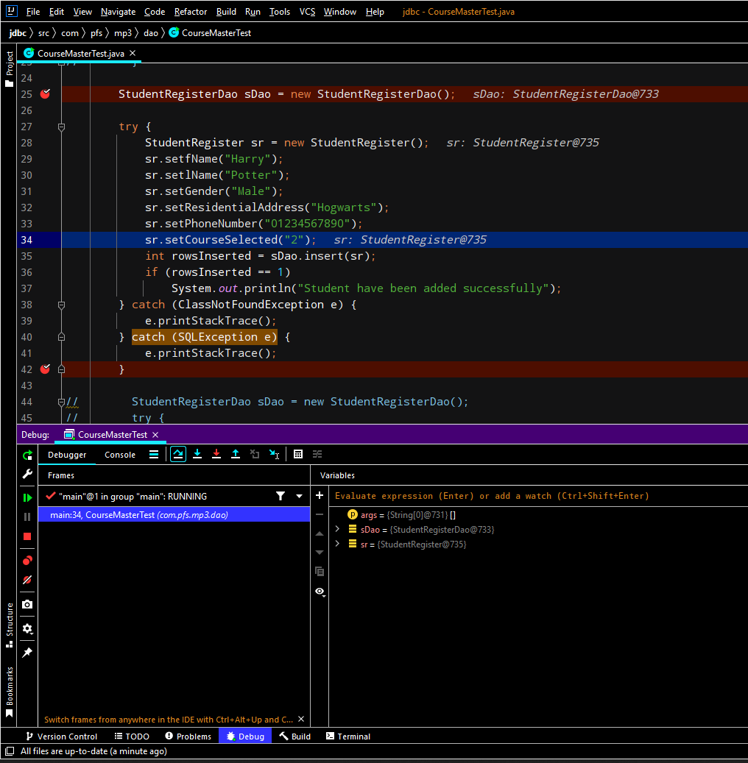
9. UAT Test Cases (5)
IDE in Debugging Mode

Slide 20
10. Milestone Feedback & Action taken
Project Milestone ID | Milestone Feedback received from Tutor / Learning Facilitator | Action Taken (Yes / No)
1
2
3
4
5
Notes:
20

Slide 21
11. Project Results
Link for the Project
http://localhost:8080/WebContents/register.jsp

Slide 22
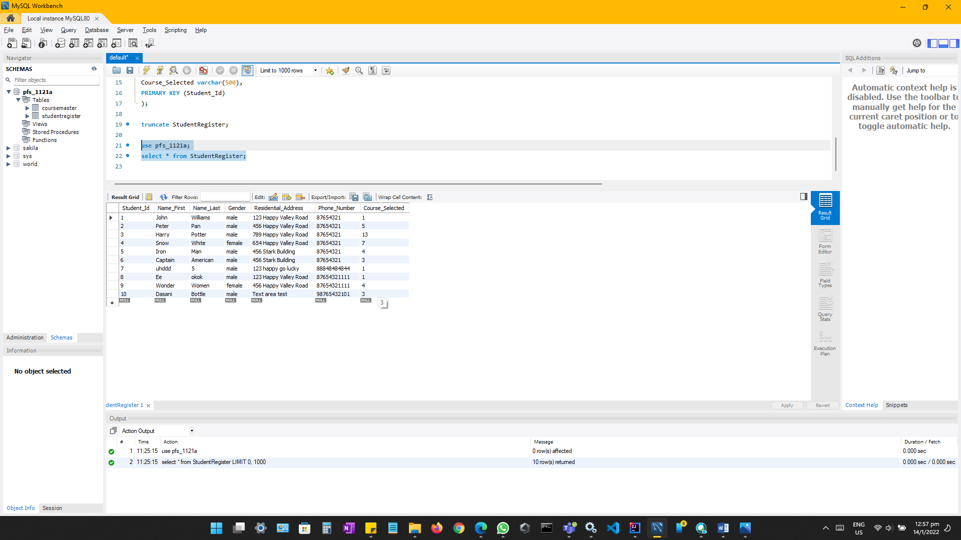
11. Project Results
Screen Shots of Evidences
Before adding, the record shows up to 10.
Notes:
22

Slide 23
11. Project Results
Screen Shots of Evidences
Default form values. http://localhost:8080/WebContents/register.jsp

Slide 24
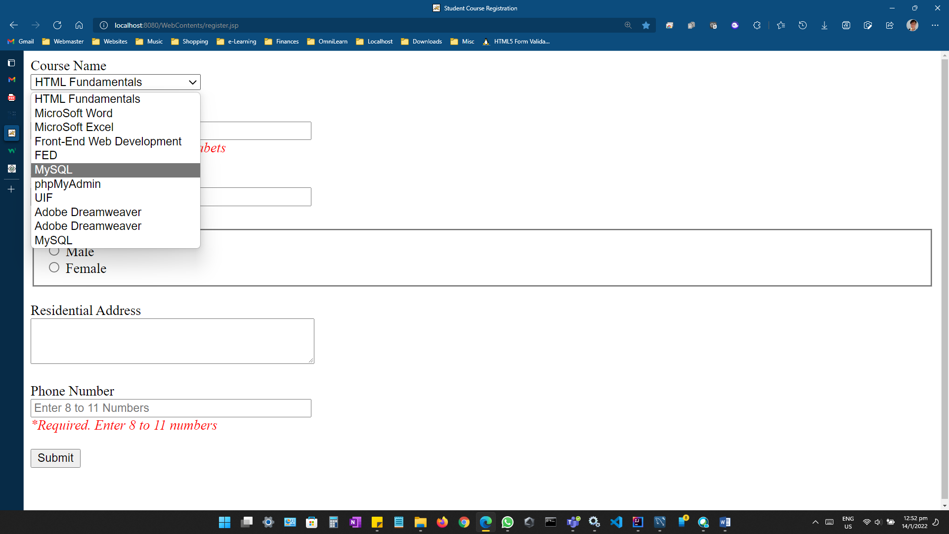
11. Project Results
Screen Shots of Evidences
Shows the dropdown options fetched from pfs_1121a_coursemaster.sql

Slide 25
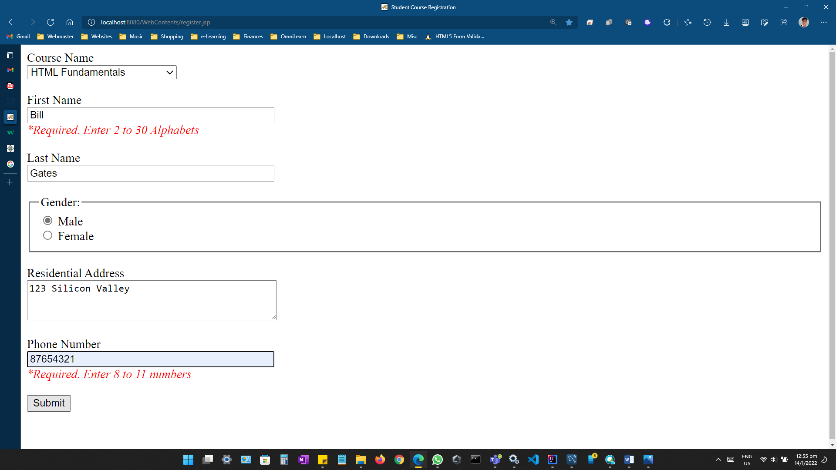
11. Project Results
Screen Shots of Evidences
Entering a new registrant Bill Gates

Slide 26
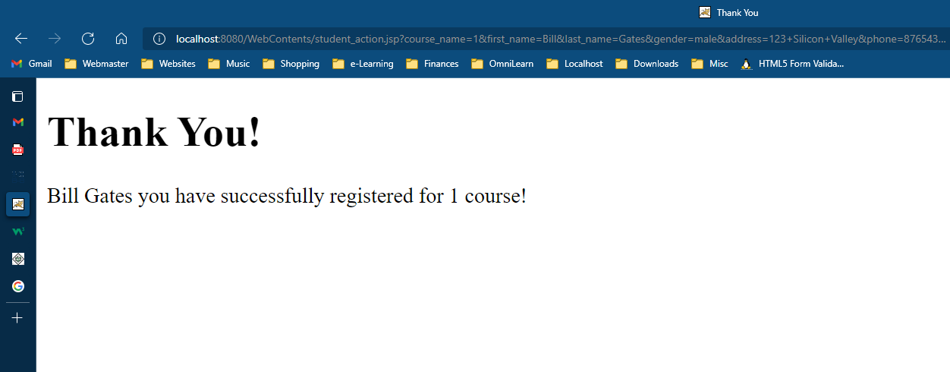
11. Project Results
Screen Shots of Evidences
Form is processed by student_action.jsp with <%@ include file=“thankyou.html” %>

Slide 27
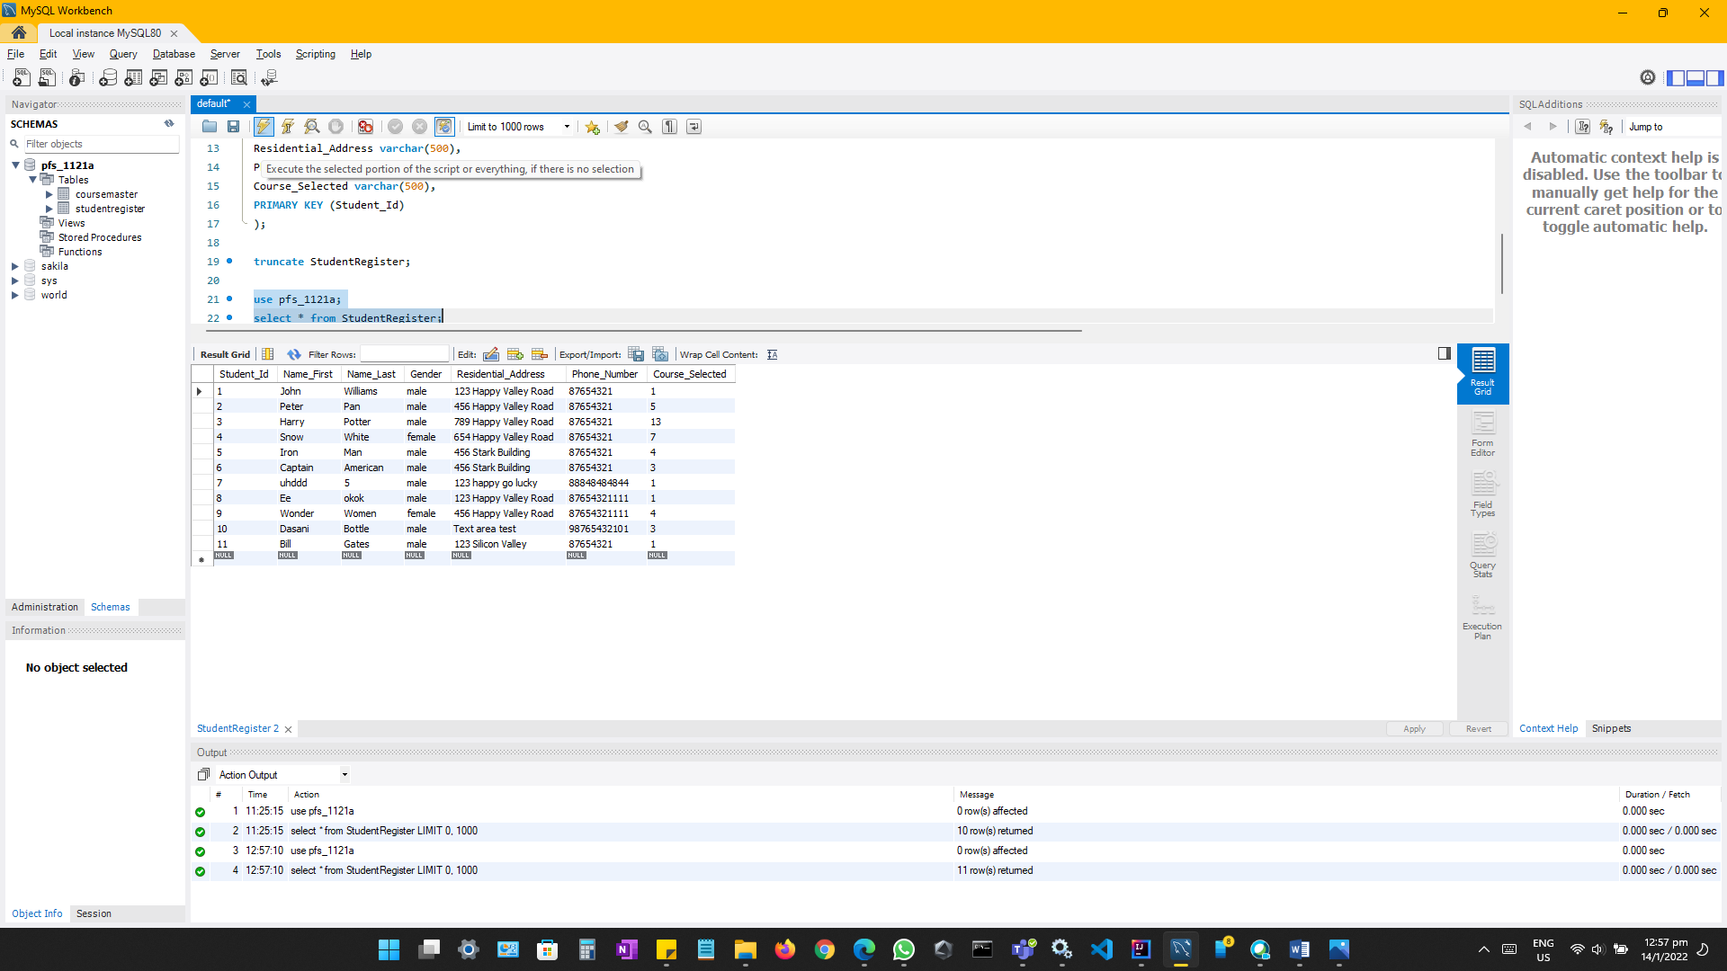
11. Project Results
Screen Shots of Evidences
Student_Id 11 added into the TABLE StudentRegister

Slide 28
12. Proposed Improvements
List of Improvements
Include a header and footer
Validation can include pseudo CSS classes
Notes:
28

